Slide 1
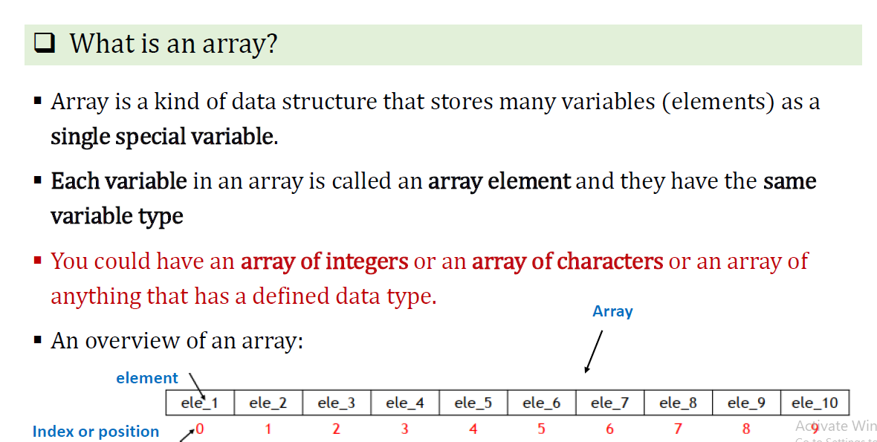
Array

Slide 2
Array
To declare an array, we have to choose
Type of element in the array
Number of elements in the array
Example
    int num[3];
    float score[3];
    char gen[3];
    char name[3][20]; array of string 3 elements
To access a specific element in an array, use arrayName[index]
Example:
printf(“%d ”, num[2]);

Slide 3
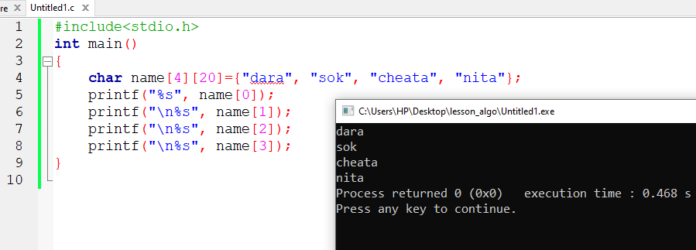
Array
Ex:

Slide 4
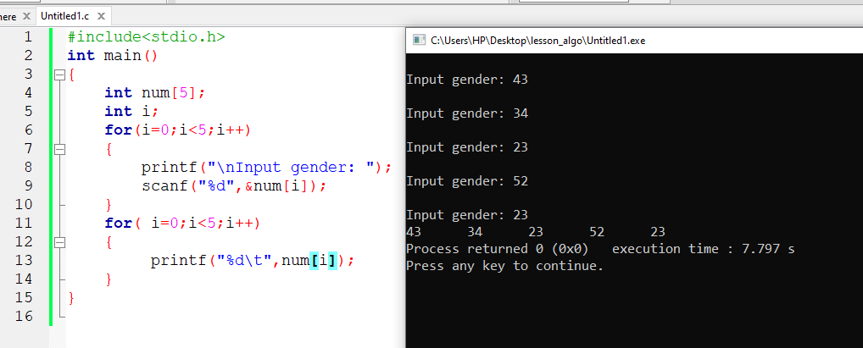
Array
EX: Write a program in C to store 5 numbers in an array
Then display

Slide 5
Exercise
Write a C program to store information 4 students in array . Each student has name, gender, major. Then display all information.
Write a C program to 7 number in array then find Sum of all numbers and diplay.

